Slide 1
Decision Trees
Making decisions

Slide 2
Decision Making
What is decision making?
Receive information about the state of the world
Also use information about internal state e.g. health
Output some action
Action should change world state to agents advantage e.g. less enemies present
Actions can have two classes of effects
Actions that change the world state
Actions that change AI’s internal state

Slide 3
Algorithms For Decision Making
State machines are one example
Quite simple
There are more complex
Neural networks
Planning algorithms
We will look at another simple one today
Decision trees

Slide 4
What Is A Decision Tree
Formalisation Of Nested If’s
Helps control large number of nested if statements
Allow visual design
Allows easy debugging
What is a tree
Has a root node representing first decision
Two (or more) child nodes descending from each parent node
Ends at leaf nodes
Decision trees usually have only two child nodes from each (binary trees)
Each node represents a condition check
Each child represents a choice
Depending on result of condition check
Each leaf node represents an action

Slide 5
The Algorithm
Start at root node
Test condition at node
If condition evaluates to true
Descend to the yes child node
Otherwise
Descend to the no child node
Repeat process until leaf node reached
This is the action taken
More important conditions need to be checked higher in the tree
E.g. a health check should be made before an attack check
More common conditions should be checked first
Improves performance

Slide 6
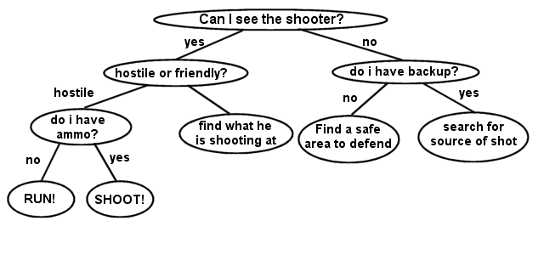
Example

Slide 7
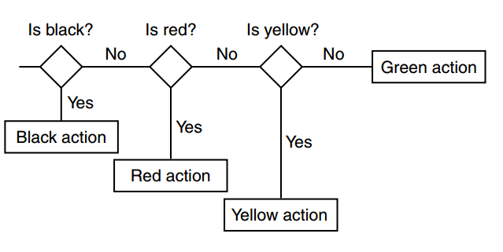
Variable Types
Boolean
Easy, just a binary choice
Multi-Valued
Use < and > to test e.g. ammo < 5
When using multiple enum multi valued
Use multiple nodes in series (see diagram)
Continuous Valued
Again, use < and > e.g. distance > 7.9

Slide 8
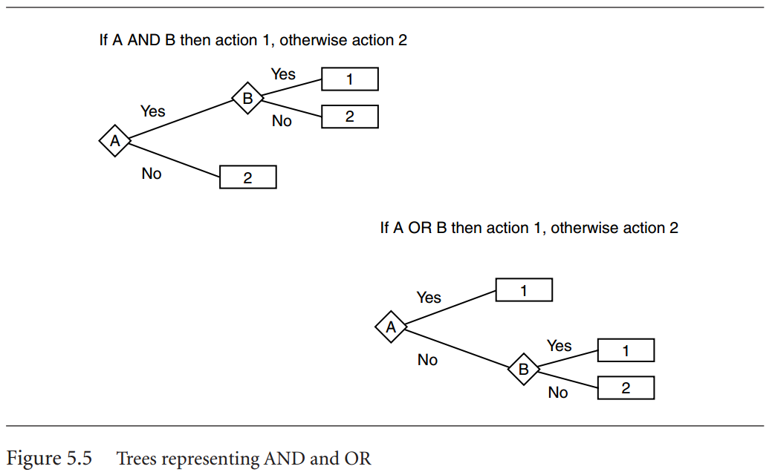
Combining Conditions (And / Or)
Decision trees support arbitrary combinations of decisions with and and or relations
These are expressed by combining nodes and leaves such that a specific decision can be reached by different routes
See the example to the right
From Artificial Intelligence For Games: Ian Millington, John Funge

Slide 9
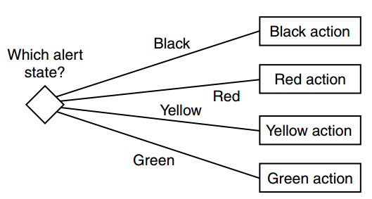
Non-Binary Trees
A node can have more than two child nodes
Can give slight improvement in performance
But can be harder to debug
However, binary trees can do anything non-binary trees can do
So binary trees almost always used

Slide 10
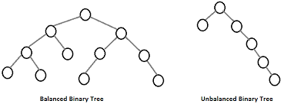
Tree balance
Tree data structures can become unbalanced
This means too many branches on one side
Make traversal slower
Always try to balance trees

Slide 11
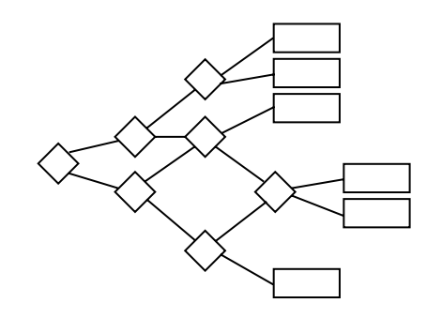
Merging Branches
Trees can merge branches
Allows a node to be reached from more than one location
Beware of looping back when doing this

Slide 12
Stochastic Trees
Binary Trees can have a random element
Just like state machines
The choice of left or right branch determined by random choice
Of course, should still be primarily controlled by input
For example: if health low 70% chance flee, 30% chance attack

Slide 13
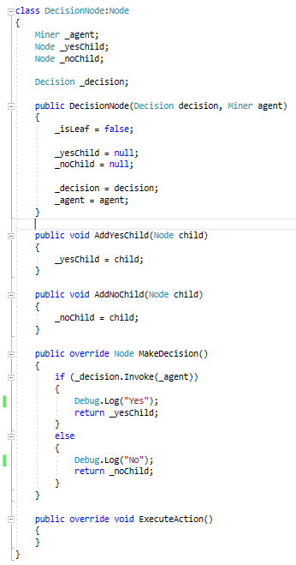
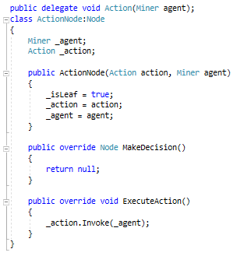
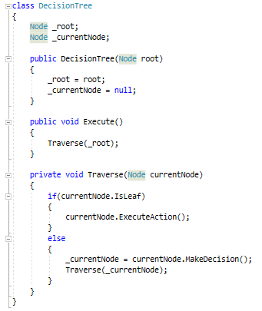
Example Code

Slide 14
Recursive Tree Traversal Method

Slide 15
Pros and cons
Pro’s
Modular
Simple to implement
Easy to debug
Efficient
Can be learned (we’ll look at this later)
Con’s
Needs careful design
Small change in input can result in large change in output

